Slide 1
www.MINEPORTAL.in ONLINE TEST SERIES FOR GATE MINING COAL/METAL FIRST/SECOND CLASS COAL INDIA MT MINING EXAM OVERMAN/SIRDAR EXAM OTHER PSU MANAGEMENT TRAINEE EXAM FREE STUDY MATERIAL/VIDEO LECTURES ONLINE ORDER MINING BOOKS CALL/WHATSAPP-8804777500 www.fb.com/mineportal.in

Slide 2
Diamond drill bits

Slide 3
Contents:
Introduction
Diamond
Diamond drill bits
Reason to use
Properties of diamond
Types of diamond bits
Diamond wire cutting
Advantages
disadvantages

Slide 4
General properties of diamond:
Class | Native Elements
Sub class | Non Metalics
Group | Carbon
Hardness | 10
Melting point | 3820K

Slide 5
Physical properties of diamond:
Colour | Variable(Paleyellow, Green,White,Blue,Black,&colourless)
Lusture | Waxy
Transparency | Transparent to Translucent
Crystal system | Isometric
Specific gravity | 3.5

Slide 6
Cont…
Fracture | Concoidal
clevage | Perfect in 4 direc..(octahedrons)
Streak | White
Refractive index | 2.4

Slide 7
Diamond:
What is Diamond?
Diamond is polymorph
of carbon.
It is hard and excellent electrical insulator.

Slide 8
Diamond drill bit:
What is diamond drill bit?
Diamond drill bit is drilling tool which consists of diamonds, that are embedded at the tip of the drill bit.

Slide 9
Reason to use diamond drill bit:
Diamond is the hardest material than any other materials.
So by its hardness property we can use it in the drilling purposes.
Any hard rocks or other hard materials can be easily drilled by diamond drillbit.

Slide 10
Types of diamond drill bit:
surface-set diamond bits
Diamond impregnated bits
Synthetic Diamond Gear Type Impregnated Core Bits
Surface Diamond Non-coring Bits
PDC bit
The thin-wall diamond core bits

Slide 11
Surface-set diamond bits:
The surface-set diamond bits are set with a singular layer of natural diamond utilizing a hard matrix compound on the face of the bit.
The diamond set design ensures sufficient overlap to prevent premature wear of the matrix.
Surface set bits achieve maximum results when used for drilling in soft and medium hard formations.

Slide 12
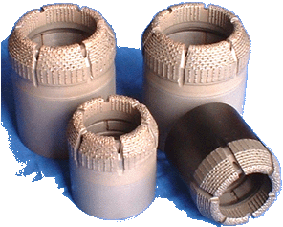
Surface-set diamond bits:

Slide 13
Diamond impregnated bits:
Diamond impregnated bits are cylindrical shapes in which the diamonds are embedded at cylindrical edges.
The carefully selected grades of high quality synthetic diamonds are distributed in the depth of impregnated bit's matrix series.
The matrix layer of the crown contains a uniform distribution of these crystal that are embedded in a powdered metal bond.

Slide 14
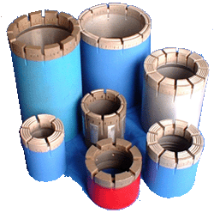
Diamond impregnated bits:

Slide 15
Synthetic Diamond Gear Type Impregnated Core Bits:
Synthetic Diamond Gear Type Impregnated Core Bits are cylindrical and zigzag at the tip at which the diamonds are embedded on it.
It is specially designed for drilling in very hard and slipped formation rock .
It's faster obviously to drill in very hard and low abrasive rocks.
If using in the suitable rock, the drilling speed is more faster than others.

Slide 16
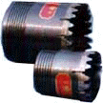
Synthetic Diamond Gear Type Impregnated Core Bits:

Slide 17
Surface Diamond Non-coring Bits:
Surface Diamond Non-coring Bits are drilling for broken formation rock which can't be cored.
Crown are used to set with natural diamond or polycrystalline diamonds.
It's used for drilling in softer to medium hard formation rocks

Slide 18
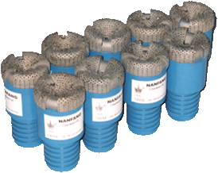
Surface Diamond Non-coring Bits:

Slide 19
PDC bit:
PDC bit is developed in a significant advanced technology of diamond drilling.
The disc shaped polycrystalline diamond pads, or cutters, are set strategically in rows on the bit face, these cutters consist of a layer of polycrystalline diamond on a tungsten carbide substrate and it allows the bits to drill through formations which are too soft or too sticky for conventional diamond drill bits,
The PDC bits are designed for vertical, slant or horizontal drilling and can be used for either non core, side track or recovery purpose.

Slide 20

PDC bit:

Slide 21
The thin-wall diamond core bits:
The thin-wall diamond core bits are hole makers for granite slabs, marble slabs.
It make hole rule, smooth, high-efficiency, lower strength and insuring engineering quality.

Slide 22
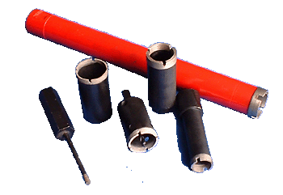
The thin-wall diamond core bits:

Slide 23
Diamond wire cutting:
Diamond wire cutting (DWC)is the process of using wire of various diameters and lengths, impregnated with diamond dust of various sizes to cut through materials.
Because of hardness of diamonds, this cutting technique can cut through almost any material that is softer than the diamond abrasive.
1m diamond wire rate is $416.6.

Slide 24
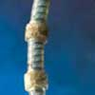
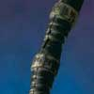
Types of Diamond wires:
Plastic Injection Molded:
Rubber Injection Molded :

Slide 25
Advantages:
Minimal noise and debris
Faster cutting than conventional methods
Minimal vibration
Unusual configurations are easily cut
Difficult or dangerous access areas can be cut with safety
Cuts underwater

Slide 26
Disadvantages:
Diamond wires are more expensive.
Breaking of diamond wires may be a major problem.
The diamond abrasive is mechanically attached to the wire, there is the trend to lose cutting effectiveness after a few cuts because most of the abrasive is worn off the wire.
This cause the last cut may take much longer than the first cut making production timing high.

Slide 27
Thankyou...

